Slide 1
Data Mining: Exploring Data
Lecture Notes for Chapter 3
Introduction to Data Mining
by
Tan, Steinbach, Kumar

Slide 2
What is data exploration?
A preliminary exploration of the data to better understand its characteristics.
Key motivations of data exploration include
Helping to select the right tool for preprocessing or analysis
Making use of humans’ abilities to recognize patterns
People can recognize patterns not captured by data analysis tools
In this chapter we will discuss
summary statistics, visualization, and On-Line Analytical Processing (OLAP).
Summary statistics, such as the mean and standard deviation of a set of values, and
visualization techniques, such as histograms and scatter plots, are standard methods that are widely employed for data exploration.
OLAP, which is a more recent development, consists of a set of techniques for exploring multidimensional arrays of values .

Slide 3
Exploratory Data Analysis (EDA)
Topics covered in this chapter also overlaps the area known as EDA.
Related to the area of Exploratory Data Analysis (EDA)
Created by statistician John Tukey
Seminal book is Exploratory Data Analysis by Tukey
A nice online introduction can be found in Chapter 1 of the NIST Engineering Statistics Handbook
http://www.itl.nist.gov/div898/handbook/index.htm

Slide 4
Techniques Used In Data Exploration
In EDA, as originally defined by Tukey
The focus was on visualization
Clustering and anomaly detection were viewed as exploratory techniques
In data mining, clustering and anomaly detection are major areas of interest, and not thought of as just exploratory

Slide 5
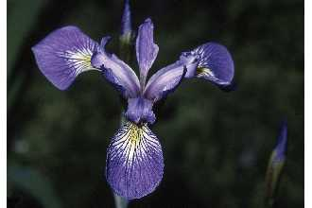
Iris Sample Data Set
Many of the exploratory data techniques are illustrated with the Iris Plant data set.
Can be obtained from the UCI Machine Learning Repository http://www.ics.uci.edu/~mlearn/MLRepository.html
From the statistician Douglas Fisher
It consists of information on 150 Iris flowers, 50 each from one of three Iris species
Three flower types (classes):
Setosa
Virginica
Versicolour
Each flowe has Five (non-class) attributes
Sepal width and length
Petal width and length
petal length in centimeters
petal width in centimeters
class (Setosa,Versicolour, Virginica)
Virginica. Robert H. Mohlenbrock. USDA NRCS. 1995. Northeast wetland flora: Field office guide to plant species. Northeast National Technical Center, Chester, PA. Courtesy of USDA NRCS Wetland Science Institute.

Slide 6
Iris Sample Data Set
Many of the exploratory data techniques are illustrated with the Iris Plant data set.
Can be obtained from the UCI Machine Learning Repository http://www.ics.uci.edu/~mlearn/MLRepository.html
From the statistician Douglas Fisher
It consists of information on 150 Iris flowers, 50 each from one of three Iris species
Three flower types (classes):
Setosa
Virginica
Versicolour
Four (non-class) attributes
Sepal width and length
Petal width and length
Virginica. Robert H. Mohlenbrock. USDA NRCS. 1995. Northeast wetland flora: Field office guide to plant species. Northeast National Technical Center, Chester, PA. Courtesy of USDA NRCS Wetland Science Institute.

Slide 7
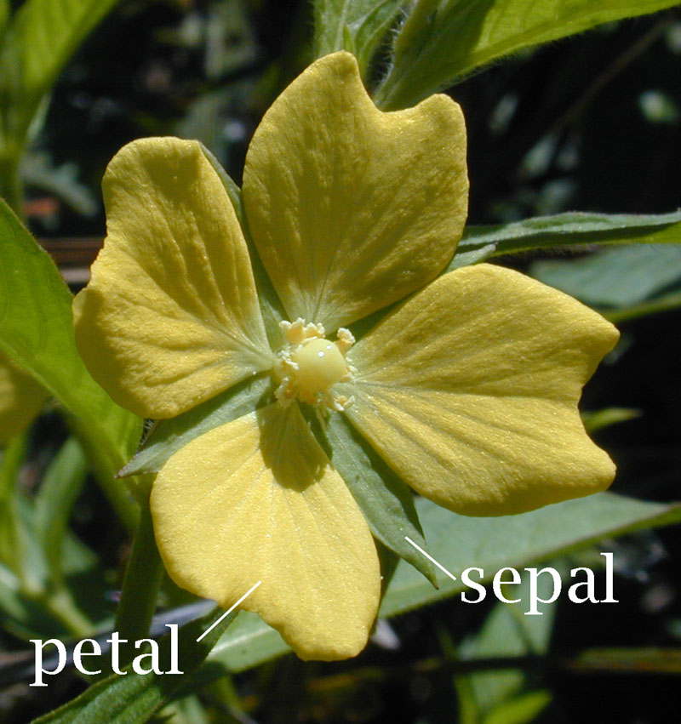

Slide 8
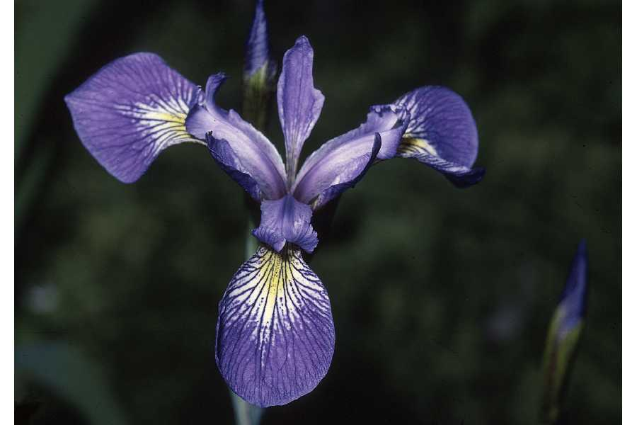

Slide 9
Summary Statistics
Summary statistics are numbers that summarize properties of the data
Summarized properties include frequency, location and spread
Examples: location - mean spread - standard deviation
Most summary statistics can be calculated in a single pass through the data

Slide 10

Frequency and Mode
The frequency of an attribute value is the percentage of time the value occurs in the data set
For example, given the attribute ‘gender’ and a representative population of people, the gender ‘female’ occurs about 50% of the time.
The mode of a an attribute is the most frequent attribute value
The notions of frequency and mode are typically used with categorical data

Slide 11
Categorical vs continuous data
Categorical attributes often, but not always, have a small number of values, and consequently, the mode and frequencies of these values can be interesting and useful.
For continuous data, the mode, is often not useful because a single value may not occur more than once. But in some cases, the mode may indicate important information about the nature of the values or the presence of missing values.

Slide 12
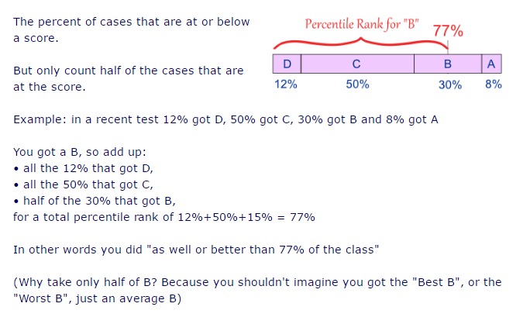
Percentile
https://www.mathsisfun.com/definitions/percentile-rank.html

Slide 13
Percentiles
For continuous data, the notion of a percentile is more useful.
Given an ordinal or continuous attribute x and a number p between 0 and 100, the p^{th} percentile x_{p} is a value of x such that p% of the observed values of x are less than x_{p} .
For instance, the 50th percentile is the value such that 50% of all values of x are less than .

Slide 14
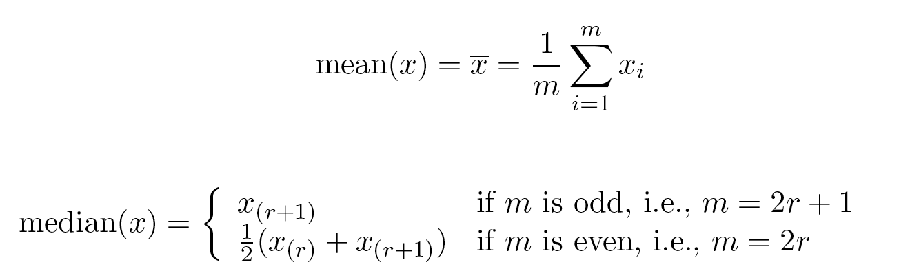
Measures of Location: Mean and Median
For continuous data, the mean is the most common measure of the location of a set of points.
However, the mean is very sensitive to outliers.
If the values are skewed then median is better choice for getting middle value.
Thus, the median (middle value) or a trimmed mean is also commonly used.

Slide 15
Trimmed mean
Example: Find the trimmed 20% mean for the following test scores: 60, 81, 83, 91, 99.
Step 1: Trim the top and bottom 20% from the data. That leaves us with the middle three values: 60, 81, 83, 91, 99.
Step 2: Find the mean with the remaining values. The mean is (81 + 83 + 91) / 3 ) = 85.
For trimming say 10% we follow 2 ways:
Some times we trim 5% on each side to make total 10%
or we can trim 10% on both of the sides. It will become total 20%

Slide 16
Measures of Spread: Range and Variance
Another set of commonly used summary statistics for continuous data are those that measure the dispersion or spread of a set of values.
Such measures indicate if the attribute values are widely spread out or
if they are relatively concentrated around a single point such as the mean.

Slide 17

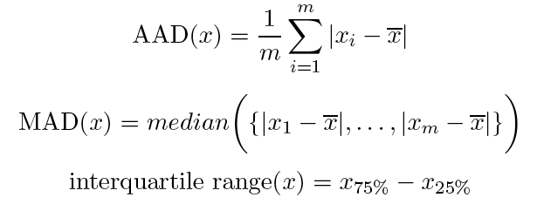
Measures of Spread: Range and Variance
Range is the difference between the max and min
The variance or standard deviation is the most common measure of the spread of a set of points.
However, this is also sensitive to outliers, so that other measures are often used.

Slide 18
Robust Measures of spread
Absolute average deviation (AAD),
the median absolute deviation (MAD),
and the interquartile range(IQR).

Slide 19
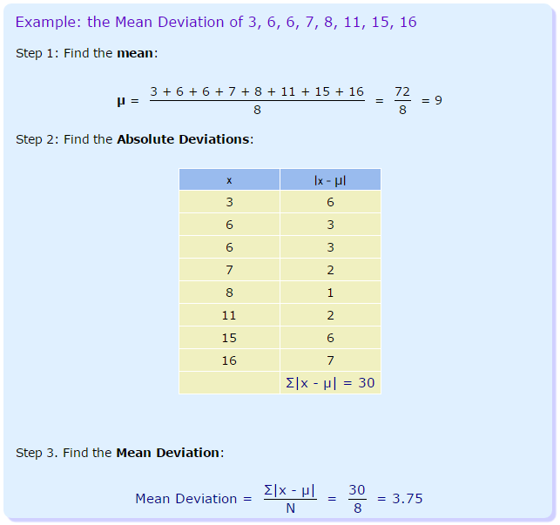
Median absolute deviation (MAD)
The mean deviation is sometimes called the Mean Absolute Deviation (MAD) because it is the mean of the absolute deviations.

Slide 20
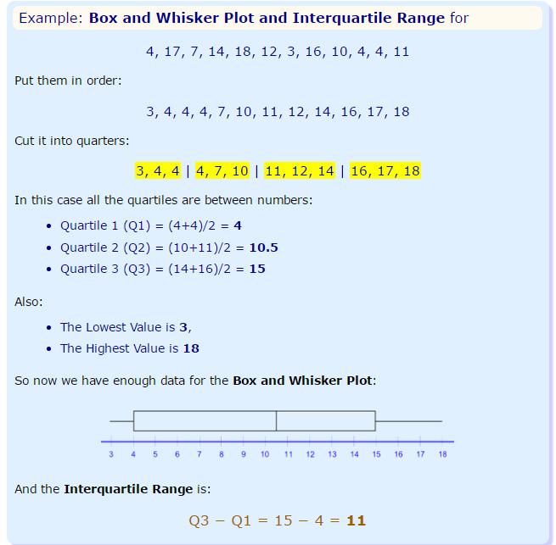
interquartile range

Slide 21

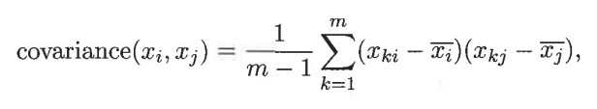
Multivariate Summary Statistics
Measures of location for data that consists of several attributes (multivariate data) can be obtained by computing the mean or median separately for each attribute.
Mean of data object x is
for data with continuous variables, the spread of the data is most commonly captured. by the covariance matrix S.
It gives you indication how strongly two attributes are (linearly) related.

Slide 22
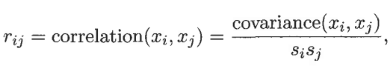
Covariance VS correlation
The problem with covariance's is that they are hard to compare: when you calculate the covariance of a set of heights and weights, as expressed in (respectively) meters and kilograms, you will get a different covariance from when you do it in other units.
So to normalize covariance we divide it by some something that represents the diversity and scale in both the covariates.
So correlation is preferred to covariance for data exploration.

Slide 23
Visualization

Slide 24
Visualization
Visualization is the conversion of data into a visual or tabular format so that the characteristics of the data and the relationships among data items or attributes can be analyzed or reported.
Visualization of data is one of the most powerful and appealing techniques for data exploration.
Humans have a well developed ability to analyze large amounts of information that is presented visually
Can detect general patterns and trends
Can detect outliers and unusual patterns

Slide 25
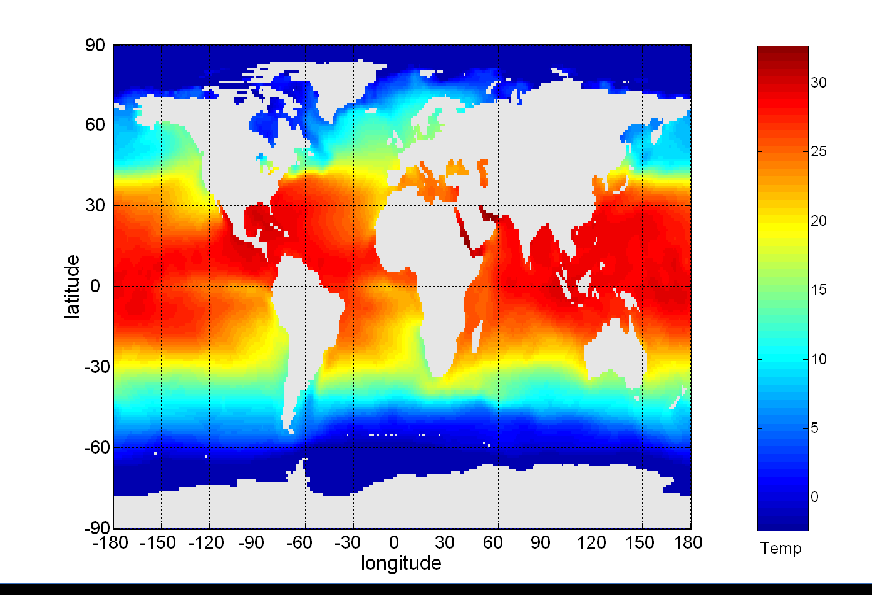
Example: Sea Surface Temperature
The following shows the Sea Surface Temperature (SST) for July 1982
Tens of thousands of data points are summarized in a single figure

Slide 26
Representation
It is the mapping of information to a visual format
Data objects, their attributes, and the relationships among data objects are translated into graphical elements such as points, lines, shapes, and colors.
Example:
Objects are often represented as points
Their attribute values can be represented as the position of the points or the characteristics of the points, e.g., color, size, and shape
If position is used, then the relationships of points, i.e., whether they form groups or a point is an outlier, is easily perceived.

Slide 27
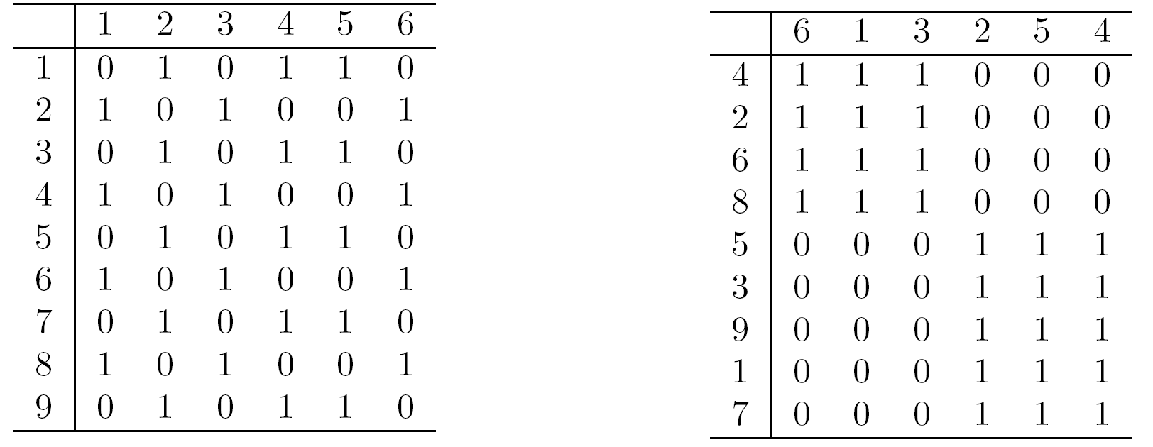
Arrangement
It is the placement of visual elements within a display
Can make a large difference in how easy it is to understand the data.
9 objects and 6 attributes are there in following Table A and B
In table A, no clear relationship
In table B, after permutation, Now two types of objects are have visible relationship. i.e All ones in first three attributes.
Example:

Slide 28
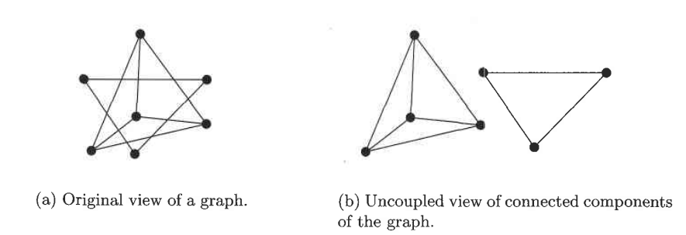
Arrangement…
When connected components of graph are separated then the relationships between nodes and graphs become much simpler to understand

Slide 29
Selection
Selection is the elimination or the de-emphasis of certain objects and attributes
Selection may involve the choosing a subset of attributes
Dimensionality reduction is often used to reduce the number of dimensions to two or three
Alternatively, pairs of attributes can be considered
Selection may also involve choosing a subset of objects
A region of the screen can only show so many points
Can sample, but want to preserve points in sparse areas

Slide 30
Dataset
Download iris.csv dataset
Download relevant text file for background knowledge
Try to analyze it by using various statistical functions like mean, median, mode, covariance n etc
Visualize data by using
Histograms
Boxplot
Scatter plot
Create a report.

Slide 31
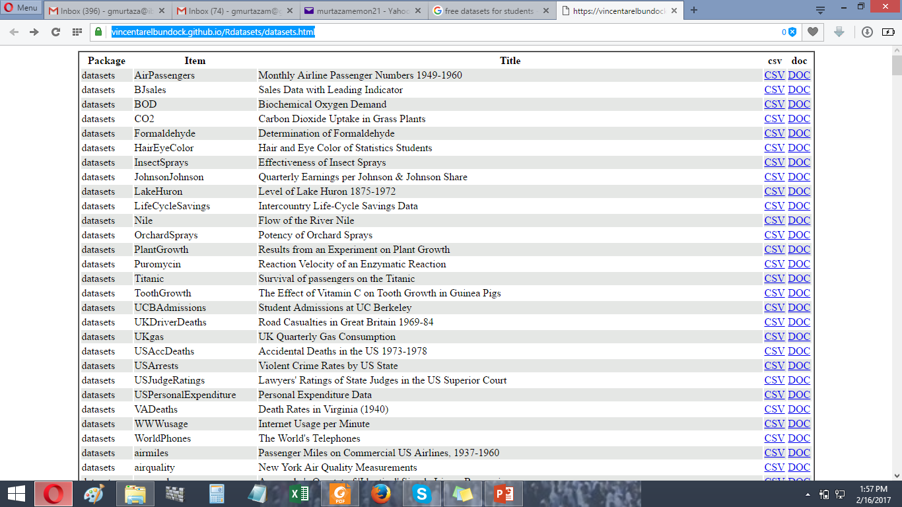
https://vincentarelbundock.github.io/Rdatasets/datasets.html

Slide 32
Visualization Techniques (VT)
VT Classification is based on
Number of attributes, (1,2,3,….n)
Data is hierarchical or graph structure
An other way of visualization classification can be based on the type of application like
scientific, statistical, or information visualization
Here we discuss categories like
visualization of a small number of attributes,
visualization of data with spatial and for temporal attributes, and
visualization of data with many attributes

Slide 33
Visualization Techniques…
Visualization of a small number of attributes
Stem and leaf Plots
Box plots
Pie Chart
Scatter plot
Empirical cumulative distribution function(ECDF)
Histograms
Use mamals.csv dataset
Use ukdriversdeath.csv dataset

Slide 34
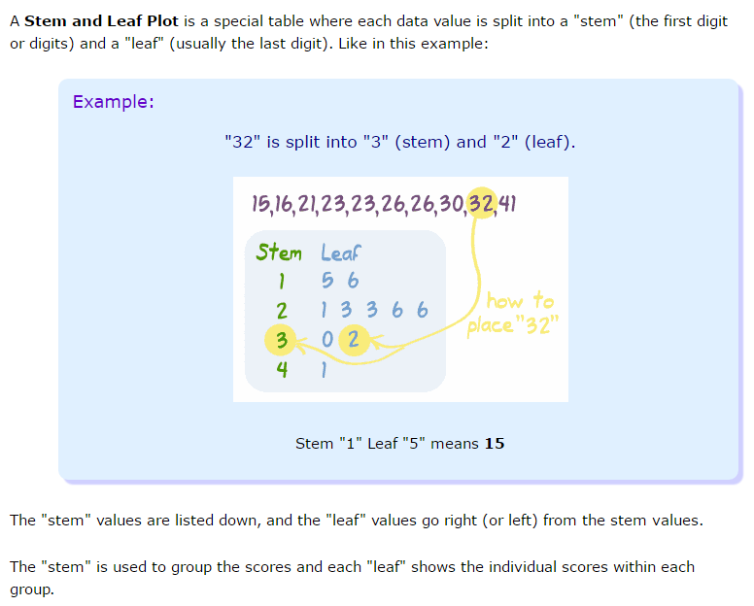
Stem and leaf Plots

Slide 35
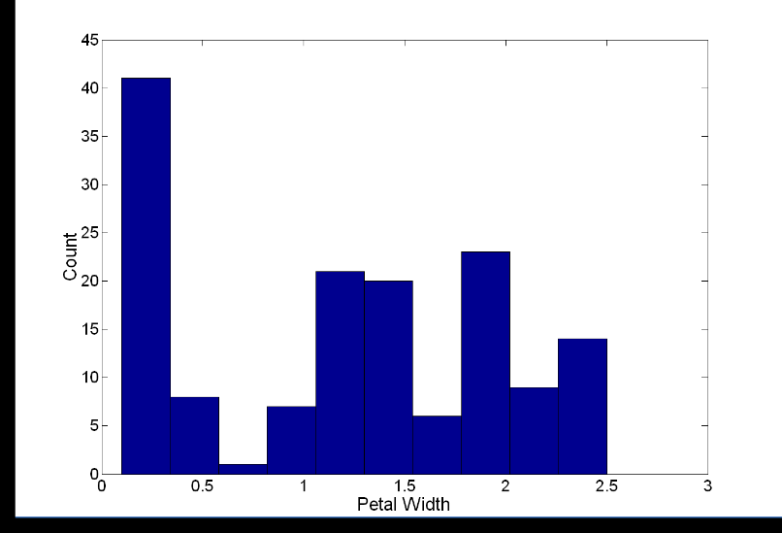
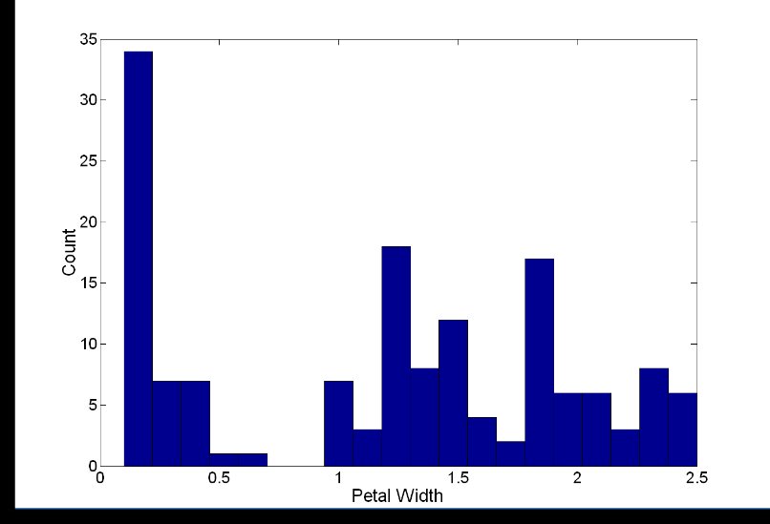
Visualization Techniques: Histograms
Histogram
Usually shows the distribution of values of a single variable
Divide the values into bins and show a bar plot of the number of objects in each bin.
The height of each bar indicates the number of objects
Shape of histogram depends on the number of bins
Example: Petal Width (10 and 20 bins, respectively)

Slide 36
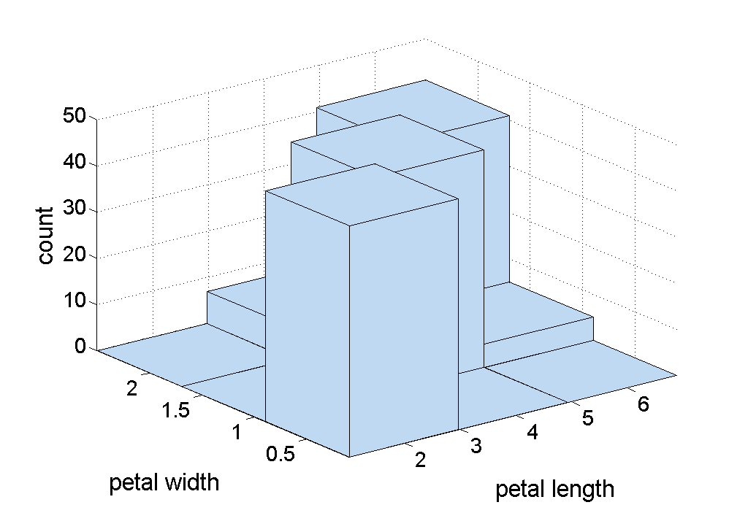
Two-Dimensional Histograms
Show the joint distribution of the values of two attributes
Example: petal width and petal length
What does this tell us?
Frequency up to 25 will have petal length<=3 and Petal width<=0.9

Slide 37
Visualization Techniques: Box Plots
Box Plots
Invented by J. Tukey
Another way of displaying the distribution of data
Following figure shows the basic part of a box plot
outlier
10th percentile
75th percentile
50th percentile
25th percentile
10th percentile

Slide 38
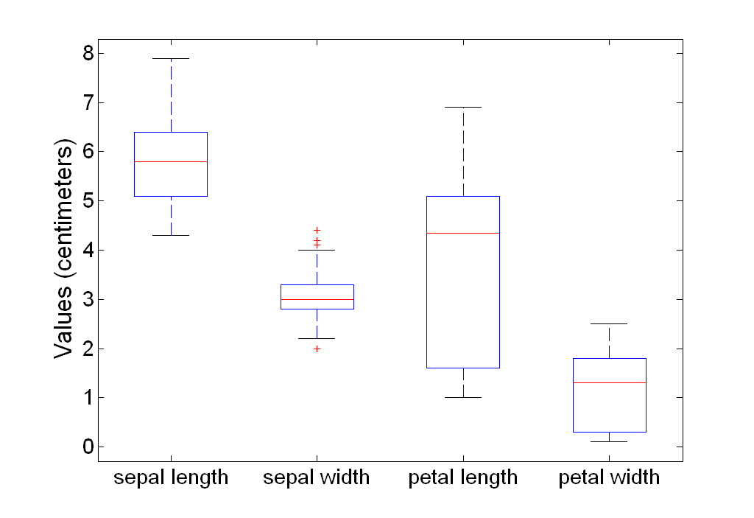
Example of Box Plots
Box plots can be used to compare attributes

Slide 39
Visualization Techniques: Scatter Plots
Scatter plots
Attributes values determine the position
Two-dimensional scatter plots most common, but can have three-dimensional scatter plots
Often additional attributes can be displayed by using the size, shape, and color of the markers that represent the objects
It is useful to have arrays of scatter plots can compactly summarize the relationships of several pairs of attributes
See example on the next slide

Slide 40
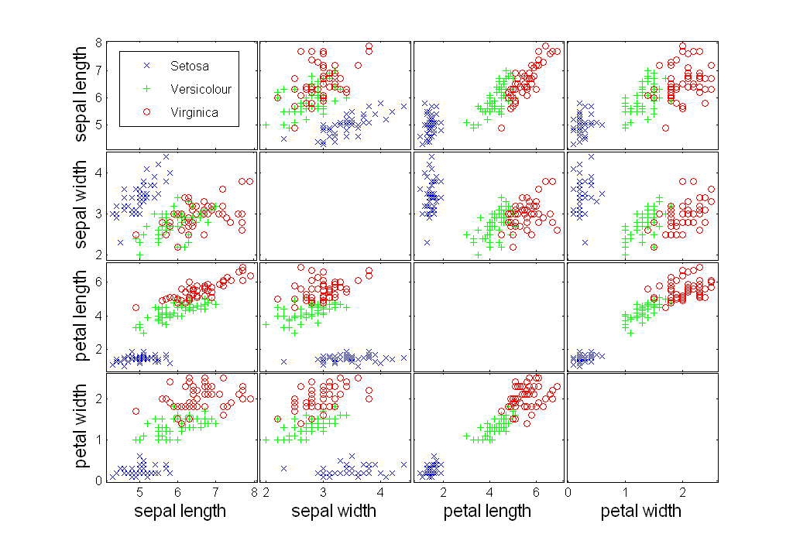
Scatter Plot Array of Iris Attributes

Slide 41
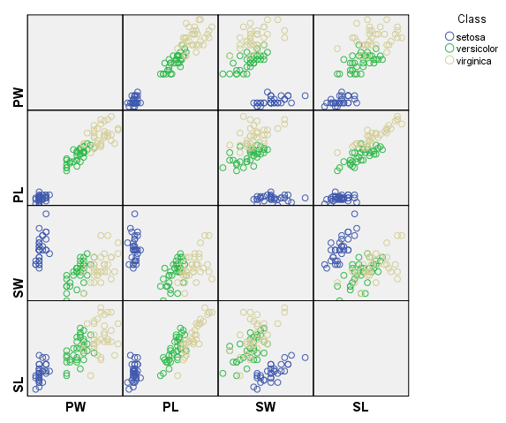

Slide 42
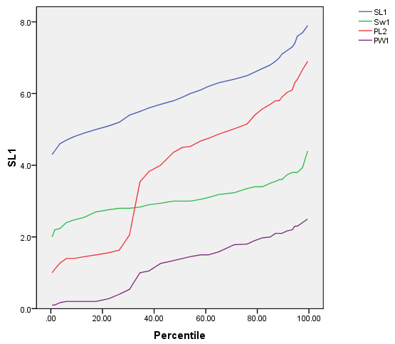
Percentile Plot for SL,PW,PL,PW

Slide 43
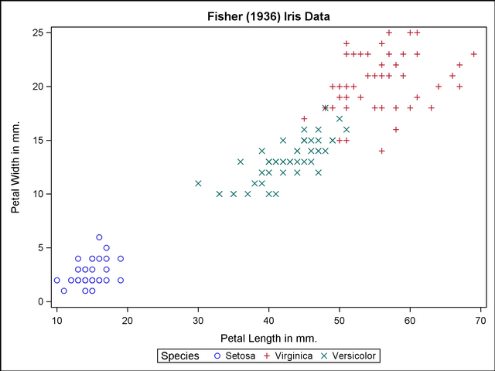
2D Scatter Plot PL, PW

Slide 44
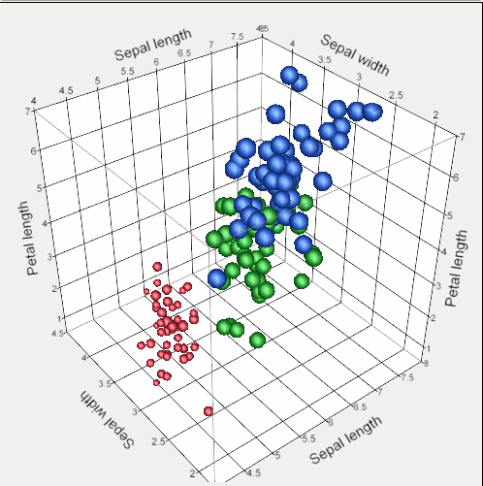
3D Scatter Plot for SW,PL,SL

Slide 45
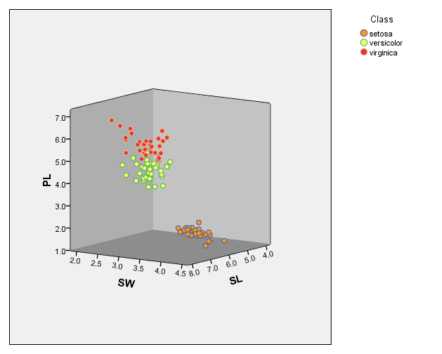

Slide 46
Visualizing Spatio-temporal data
(Surface plot, contour plot)

Slide 47
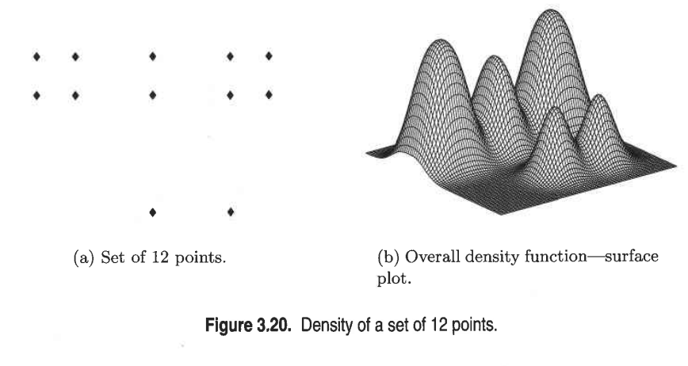
Surface Plot
two attributes for the x and y coordinates. The third attribute is used to indicate the height above the plane defined by the first two attributes
While such graphs can be useful, they require that a value of the third attribute be defined for all combinations of values for the first two attributes, at least over some range

Slide 48
Visualization Techniques: Contour Plots
Contour plots
Useful when a continuous attribute is measured on a spatial grid
They partition the plane into regions of similar values
The contour lines that form the boundaries of these regions connect points with equal values
The most common example is contour maps of elevation
Can also display temperature, rainfall, air pressure, etc.
An example for Sea Surface Temperature (SST) is provided on the next slide

Slide 49
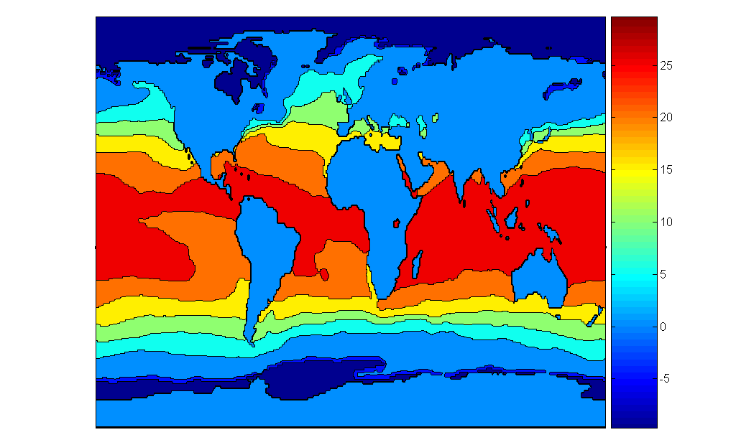
Contour Plot Example: SST Dec, 1998
Celsius

Slide 50
Visualizing of Higher dimensional data
(Matrix Plot, Coordinates Plot, chernoff face)

Slide 51
Visualization Techniques: Matrix Plots
Matrix plots
Can plot the data matrix
This can be useful when objects are sorted according to class
Typically, the attributes are normalized to prevent one attribute from dominating the plot
Plots of similarity or distance matrices can also be useful for visualizing the relationships between objects
Examples of matrix plots are presented on the next two slides

Slide 52
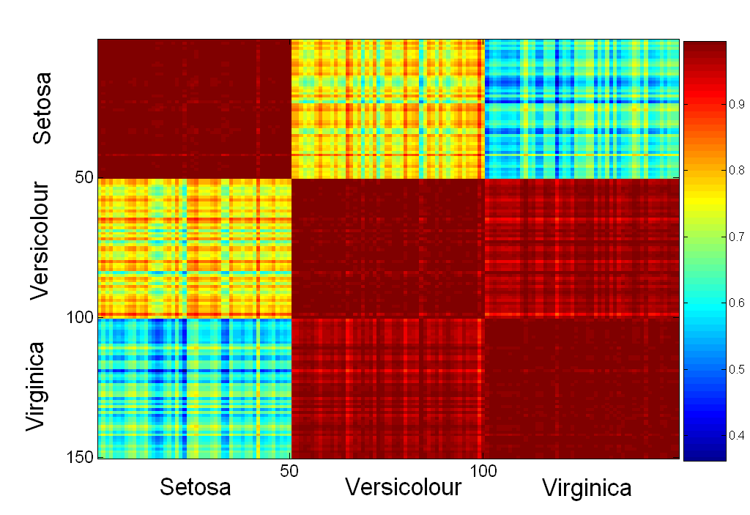
Visualization of the Iris Correlation Matrix

Slide 53
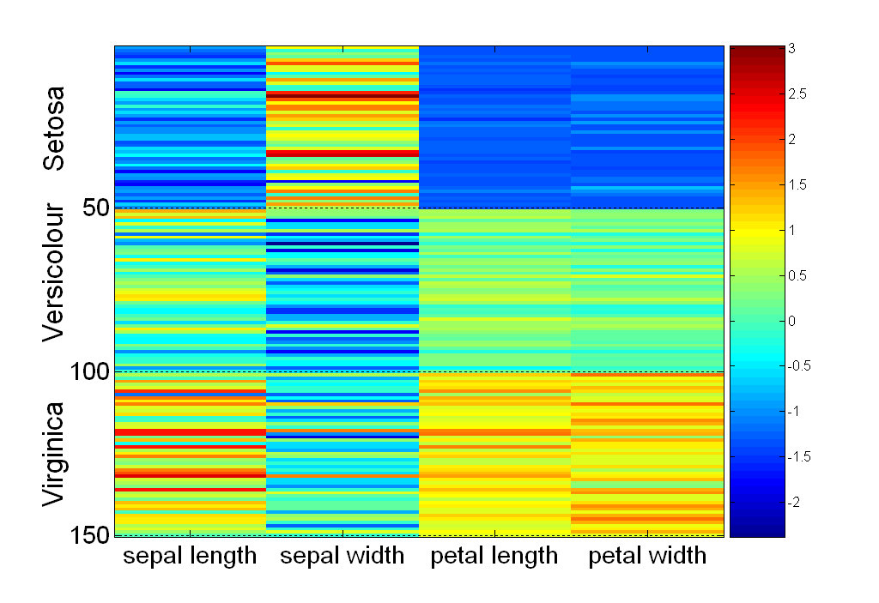
Visualization of the Iris Data Matrix
standard
deviation

Slide 54
Visualization Techniques: Parallel Coordinates
Parallel Coordinates
Used to plot the attribute values of high-dimensional data
Instead of using perpendicular axes, use a set of parallel axes
The attribute values of each object are plotted as a point on each corresponding coordinate axis and the points are connected by a line
Thus, each object is represented as a line
Often, the lines representing a distinct class of objects group together, at least for some attributes
Ordering of attributes is important in seeing such groupings

Slide 55
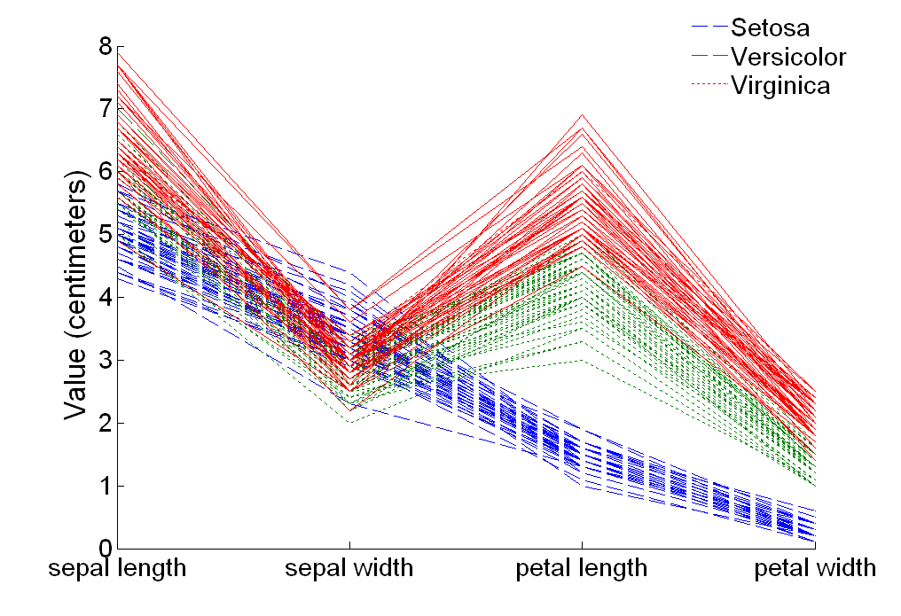
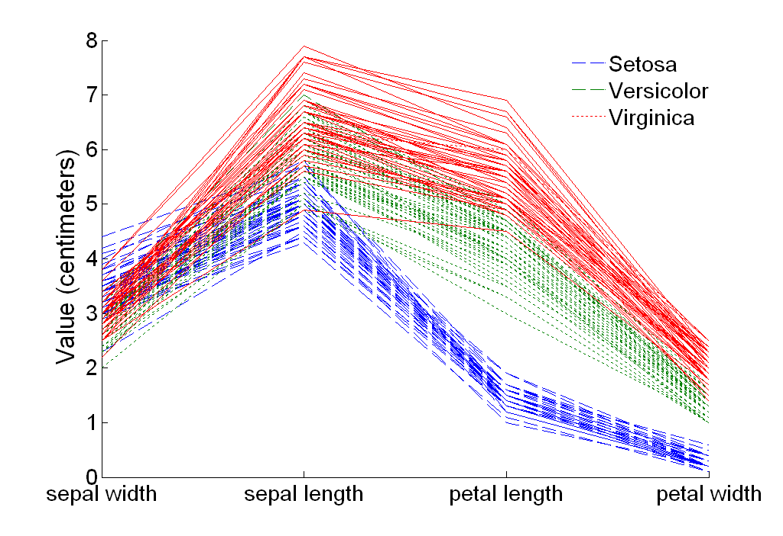
Parallel Coordinates Plots for Iris Data

Slide 56
Other Visualization Techniques
Star Plots
Similar approach to parallel coordinates, but axes radiate from a central point
The line connecting the values of an object is a polygon
Chernoff Faces
Approach created by Herman Chernoff
This approach associates each attribute with a characteristic of a face
The values of each attribute determine the appearance of the corresponding facial characteristic
Each object becomes a separate face
Relies on human’s ability to distinguish faces

Slide 57
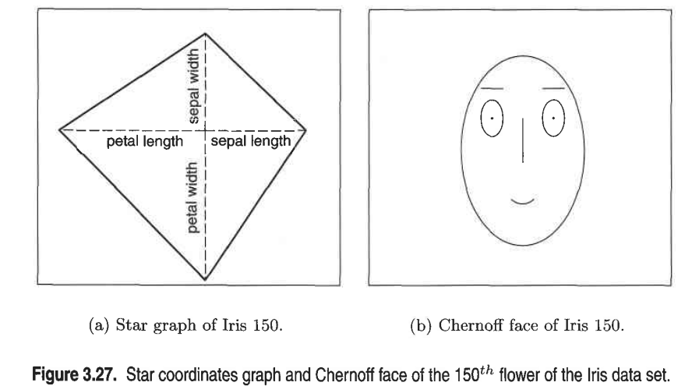

Slide 58
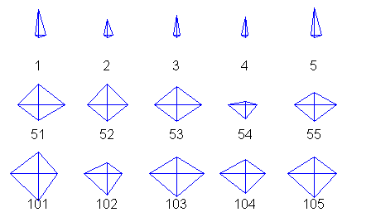
Star Plots for Iris Data
Setosa
Versicolour
Virginica

Slide 59
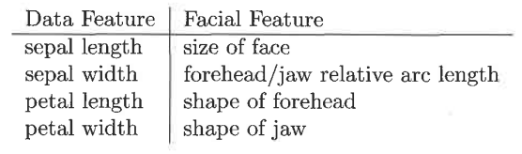

Slide 60
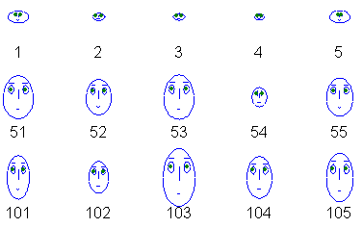
Chernoff (k-ER-n-aw-f) Faces for Iris Data
Setosa
Versicolour
Virginica

Slide 61
Do's and Don'ts of visualization
See the book.

Slide 62
On-Line Analytical Processing OLAP

Slide 63
OLAP
On-Line Analytical Processing (OLAP) was proposed by E. F. Codd, the father of the relational database.
Relational databases put data into tables, while OLAP uses a multidimensional array representation.
Such representations of data previously existed in statistics and other fields
There are a number of data analysis and data exploration operations that are easier with such a data representation.

Slide 64
Creating a Multidimensional Array
Two key steps in converting tabular data into a multidimensional array.
First, identify which attributes are to be the dimensions and which attribute is to be the target attribute whose values appear as entries in the multidimensional array.
The attributes used as dimensions must have discrete values
The target value is typically a count or continuous value, e.g., the cost of an item
Can have no target variable at all except the count of objects that have the same set of attribute values
Second, find the value of each entry in the multidimensional array by summing the values (of the target attribute) or count of all objects that have the attribute values corresponding to that entry.

Slide 65
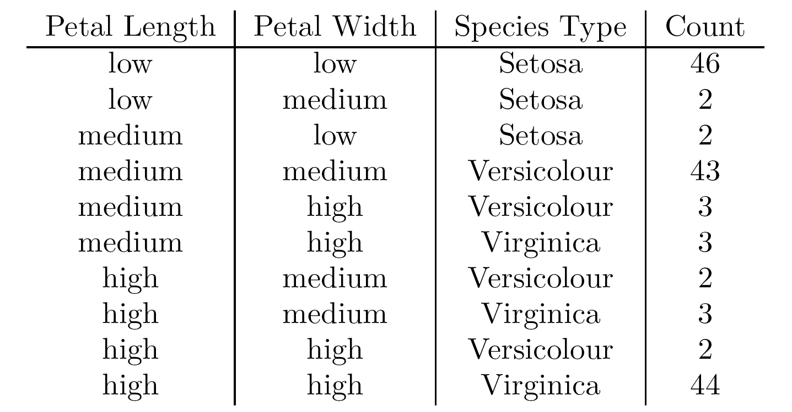
Example: Iris data
We show how the attributes, petal length, petal width, and species type can be converted to a multidimensional array
First, we discretized the petal width and length to have categorical values: low, medium, and high
We get the following table - note the count attribute

Slide 66
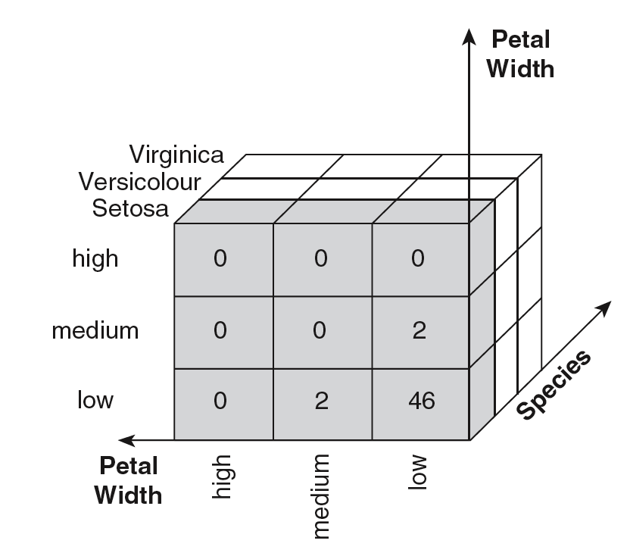
Example: Iris data (continued)
Each unique tuple of petal width, petal length, and species type identifies one element of the array.
This element is assigned the corresponding count value.
The figure illustrates the result.
All non-specified tuples are 0.

Slide 67
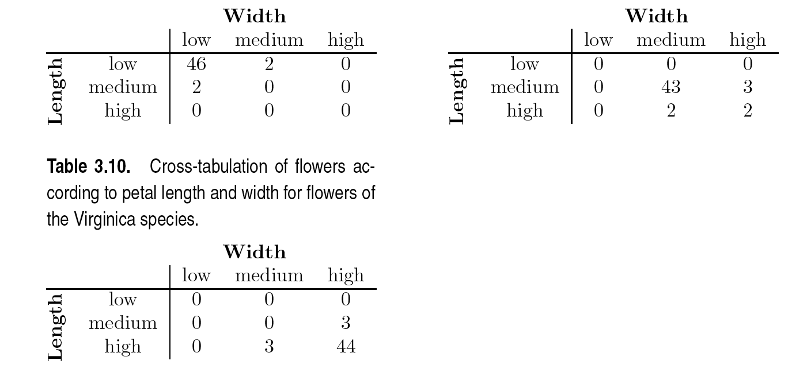
Example: Iris data (continued)
Slices of the multidimensional array are shown by the following cross-tabulations
What do these tables tell us?

Slide 68
OLAP Operations: Data Cube
The key operation of a OLAP is the formation of a data cube
A data cube is a multidimensional representation of data, together with all possible aggregates.
By all possible aggregates, we mean the aggregates that result by selecting a proper subset of the dimensions and summing over all remaining dimensions.
For example, if we choose the species type dimension of the Iris data and sum over all other dimensions, the result will be a one-dimensional entry with three entries, each of which gives the number of flowers of each type.

Slide 69
Data Cube Example
Consider a data set that records the sales of products at a number of company stores at various dates.
This data can be represented as a 3 dimensional array
There are 3 two-dimensional aggregates (3 choose 2 ), 3 one-dimensional aggregates, and 1 zero-dimensional aggregate (the overall total)

Slide 70
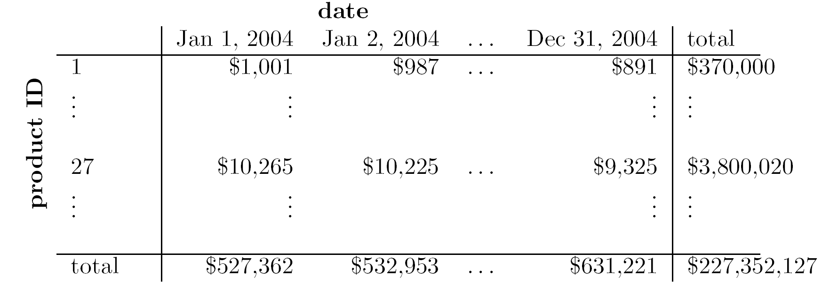
Data Cube Example (continued)
The following figure table shows one of the two dimensional aggregates, along with two of the one-dimensional aggregates, and the overall total

Slide 71
OLAP Operations: Slicing and Dicing
Slicing is selecting a group of cells from the entire multidimensional array by specifying a specific value for one or more dimensions.
Dicing involves selecting a subset of cells by specifying a range of attribute values.
This is equivalent to defining a subarray from the complete array.
In practice, both operations can also be accompanied by aggregation over some dimensions.

Slide 72
OLAP Operations: Roll-up and Drill-down
Attribute values often have a hierarchical structure.
Each date is associated with a year, month, and week.
A location is associated with a continent, country, state (province, etc.), and city.
Products can be divided into various categories, such as clothing, electronics, and furniture.
Note that these categories often nest and form a tree or lattice
A year contains months which contains day
A country contains a state which contains a city

Slide 73
OLAP Operations: Roll-up and Drill-down
This hierarchical structure gives rise to the roll-up and drill-down operations.
For sales data, we can aggregate (roll up) the sales across all the dates in a month.
Conversely, given a view of the data where the time dimension is broken into months, we could split the monthly sales totals (drill down) into daily sales totals.
Likewise, we can drill down or roll up on the location or product ID attributes.

